Slide 1
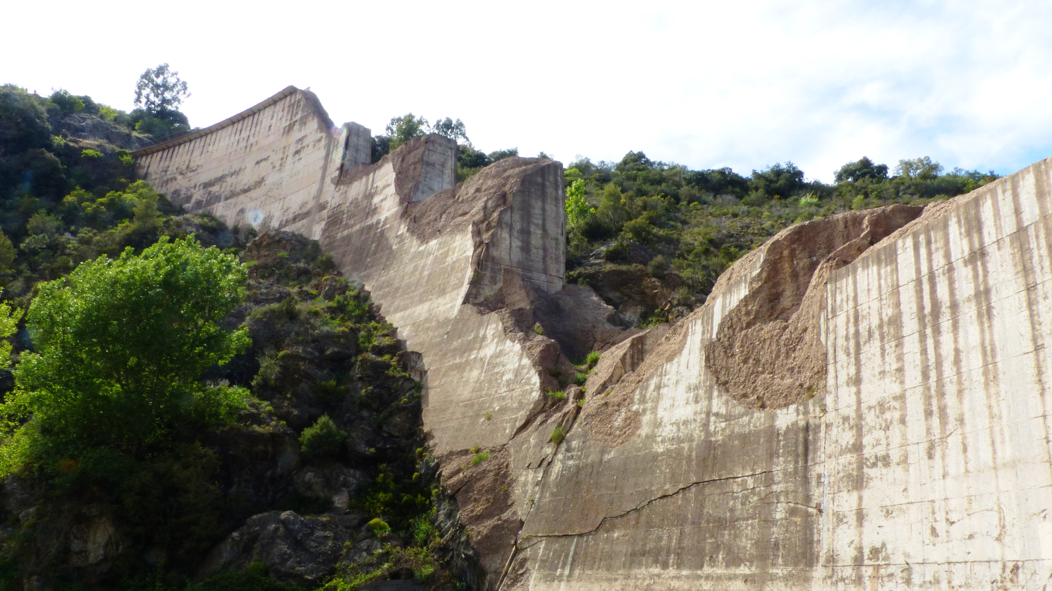
Malpasset Dam Incident Analysis
By: Neveah C, Jayden G, Jahvon J, Malik T, Dorian F, Jean Loui D
(Group 4)

Slide 2
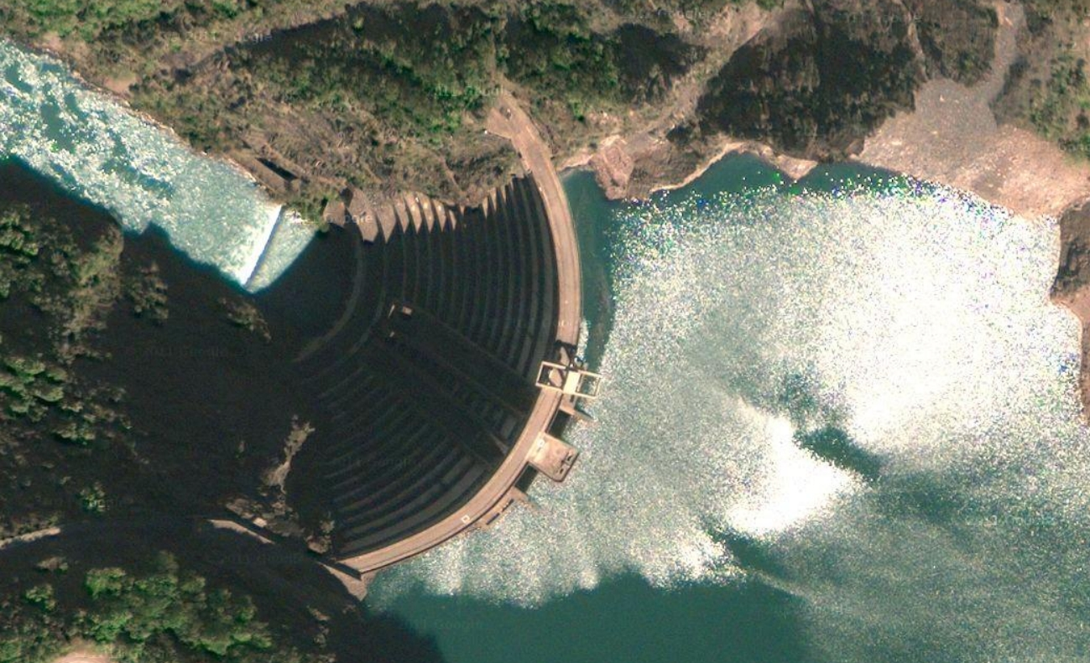
Opening Statement
In the Cannes District, close to Fréjus, in the southern region of the country of romance, the Malpasset Dam was a concrete arch dam known to many in parts of France, it collapsed due to unknown motives.
This presentation will go over this mysterious tragedy, how it happened, and its importance. It's important for DHS to make recommendations to further analyze why this tragedy took place in an ally country and to make sure it does not take place in their country.

Slide 3
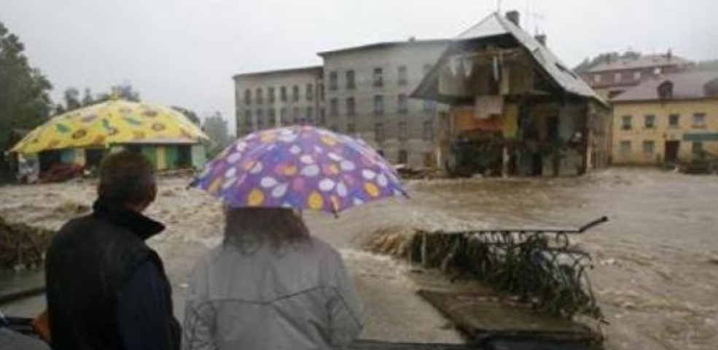
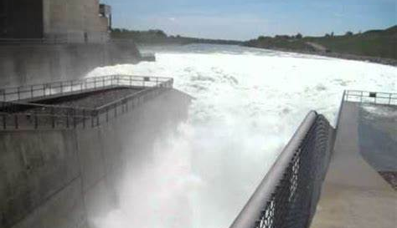
The Tragedy of the Malpasset Dam
The Malpasset Dam had a series of disastrous occurrences on March 7, 2014, around 9:35 CET, which significantly impacted France history in a catastrophic way. The flood gates opened wider than usual because of a small increase in energy output that exceeded their maximum capacity.
Numerous times, staff members at the Malpasset HED have sought to shut down the system in addition to reducing production, but each time, energy output has increased quickly.
They made an emergency announcement to evacuate the neighboring village of Cattenom after numerous attempts at getting the controls to work failed. Major flooding caused excruciating damage and destroyed the community.

Slide 4
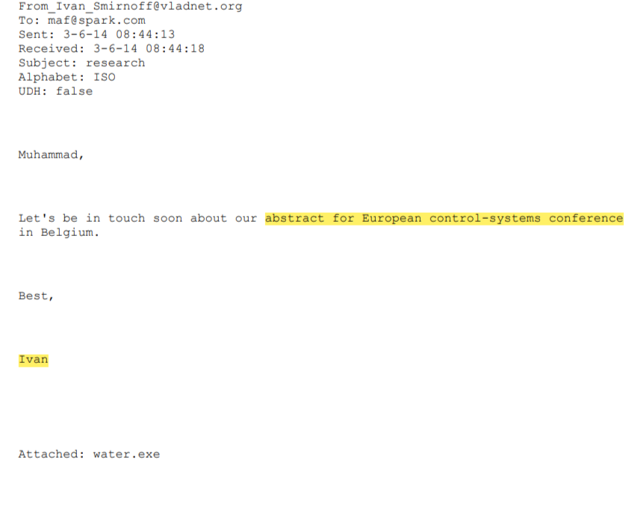

Suspects
A main suspect of the incident is Muhammad. The morning the incident occurred, Muhammad was seen texting his wife insisting that she “MUST leave the house with her parents no later than 8” he also tells her to bring their wedding photos, which much be something important to him.
He says this around 7 am, before the incident occurred around 9 am. Muhammad's whole family lived in the village. While the dam’s system was still malfunctioning, Muhammad who was supposed to be there was nowhere to be found.
He also randomly gained and took out a large sum of money after receiving an email from Ivan (another suspect) talking about their Moscow conference and abstract for their European control-systems conference.

Slide 5
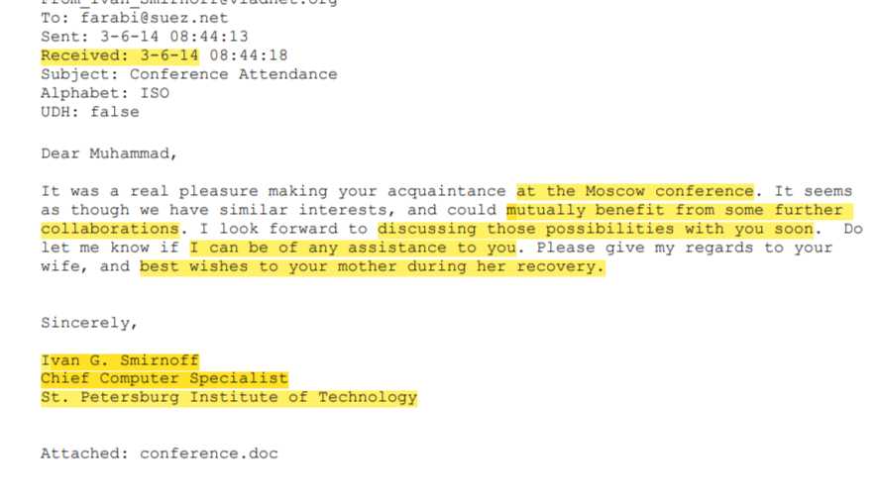
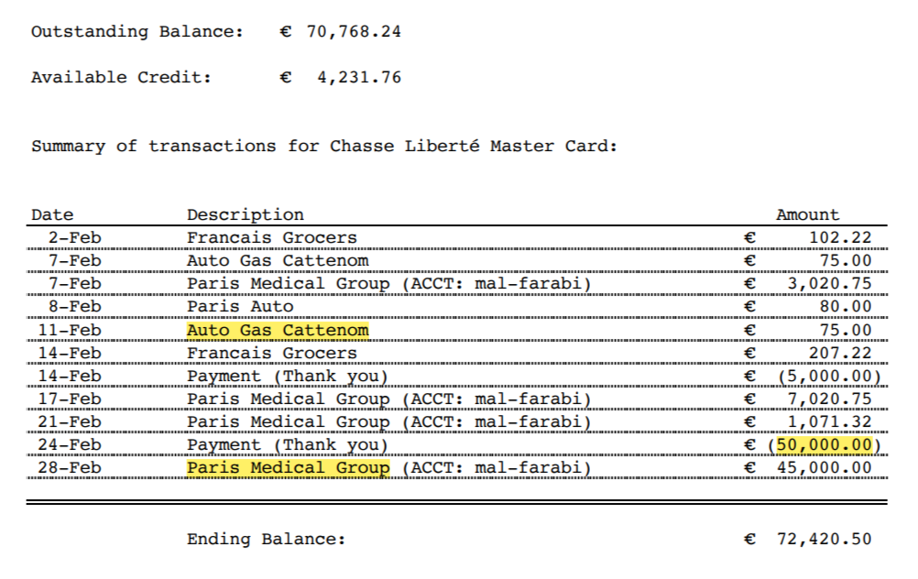
Motives
As stated before, Muhammad received a large sum of money from the Russian Government (50,000 euros) then withdrew it.
Muhammad’s mother was sick, and he may have wanted money transferred into his account to aid in her recovery as he made a payment to the Paris medical group.
He could have also needed the money for him and his family to flee, as they lived in the village near the dam which got flooded and damaged.

Slide 6
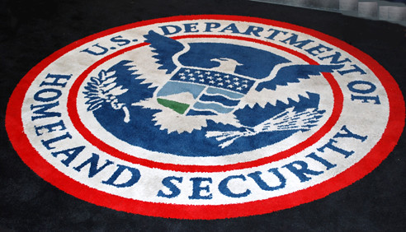
Importance to DHS
The Department of Homeland Security aims to strengthen American security. Enforcement of customs, border, and immigration laws, emergency response to natural and man-made disasters, work against terrorism, and cybersecurity are all tasks carried out by the Department.
Due to the suspicious malfunctions that occurred during the Malpasset Dam disaster, DHS is there to find out how these controls where possibly under a cyberattack or any other form of attack, resulting to the controls to be uncontrollable and unresponsive.
They also are of use to find who was behind this act of terrorism, plotting a disaster to unfold and wipe out Cattenom. This event took place in an ally country and DHS wants to make precautions to make sure it doesn’t happen in theirs as well.
This Photo by Unknown author is licensed under CC BY.

Slide 7
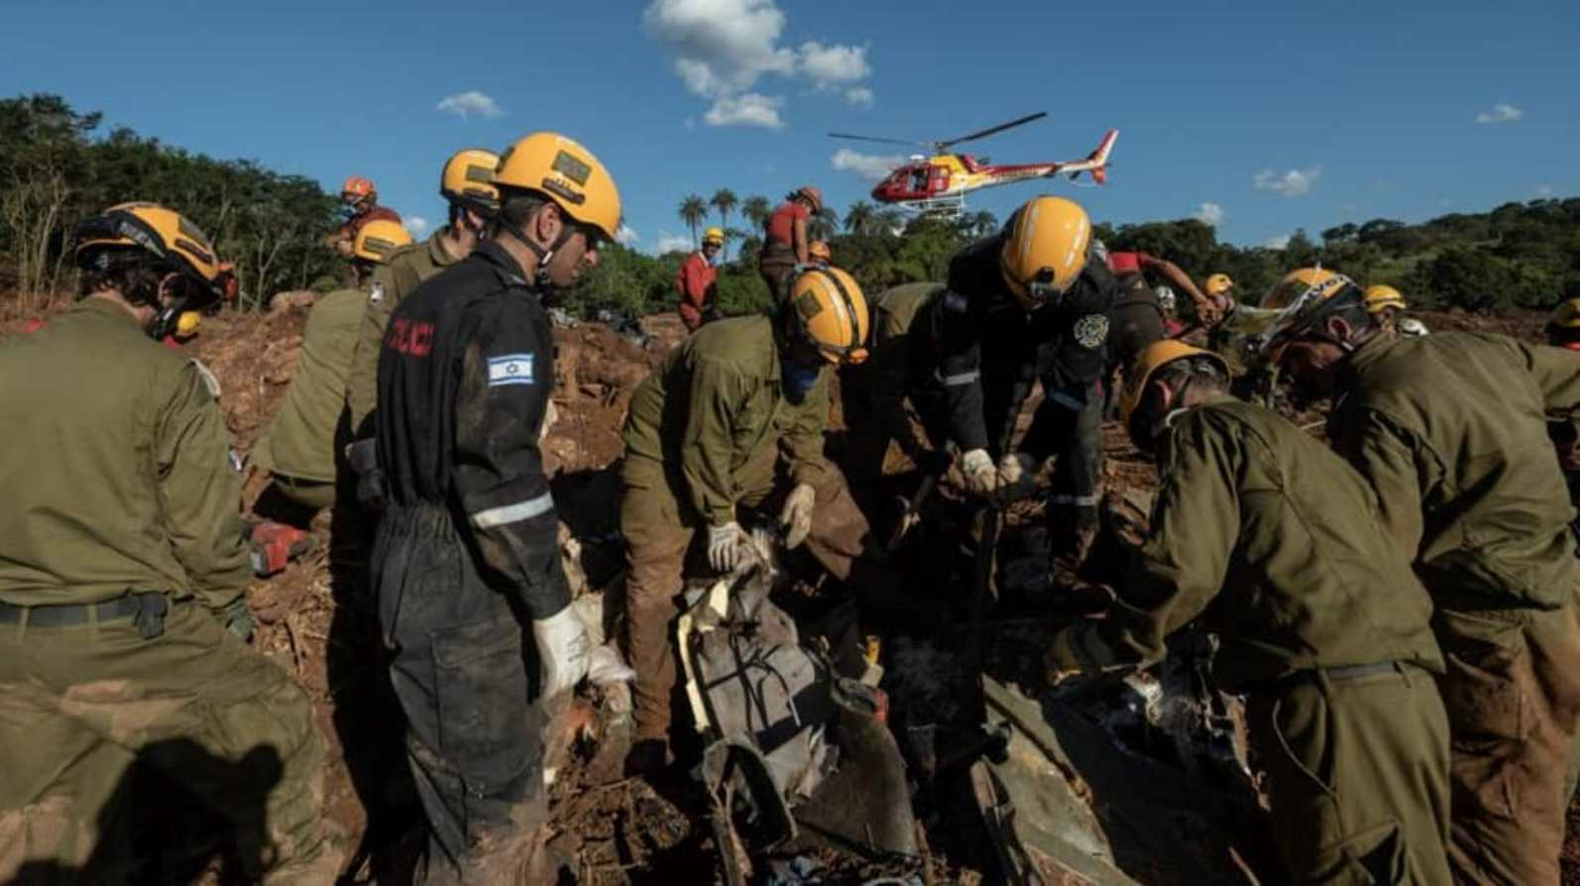
Recommendations
In the future, for countries, including France, to avoid such a tragedy they’ll need to implement specific:
Procedures: Specific procedures include rules and escape routes in case of a flood to reduce casualties and tools in case of emergencies. Also, creating a plan following each step to work through the incident, having organization. They could also include continuous vetting regularly reviewing a cleared individual's background to ensure they continue to meet security clearance requirements and should continue to hold positions of trust.
Security: For security measures we can use our cyber security experts to better help prevent these catastrophes, through filtering out specific words and phrases that relay messages of harm or knowledge to the public and sending it to the authorities. Also, detecting possible hackers who pose a threat to the security of a country or those in proximity of a dangerous area like a dam system, by placing authenticators and firewalls we can protect these systems; and viewing call logs, emails, camera footage, background checks, etc.

